Slide 1
Recommendation System

Slide 2
Market basket analysis is a data mining technique used by retailers to increase sales by better understanding customer purchasing patterns. It involves analyzing large data sets, such as purchase history, to reveal product groupings and products that are likely to be purchased together.
The adoption of market basket analysis was aided by the advent of electronic point-of-sale (POS) systems. Compared to handwritten records kept by store owners, the digital records generated by POS systems made it easier for applications to process and analyze large volumes of purchase data.
If customers are buying milk, how probably are they to also buy bread (and which kind of bread) on the same trip to the supermarket? This information may lead to an increase in sales by helping retailers to do selective marketing based on predictions, cross-selling, and planning their ledge space for optimal product placement.

Slide 3
Association Rule Mining
Generally, Association Rule Mining can be viewed in a two-step process:
Find all Frequent itemsets: By definition, each of these itemsets will occur at least as frequently as a pre-established minimum support count, min sup.
Generate Association Rules from the Frequent itemsets: By definition, these rules must satisfy minimum support and minimum confidence.

Slide 4
Association Rule Mining is primarily used when you want to identify an association between different items in a set and then find frequent patterns in a transactional database or relational database.

Slide 5
Algorithms Used in Market Basket Analysis
There are multiple data mining techniques and algorithms used in Market Basket Analysis. One of the important objectives is “to predict the probability of items that are being bought together by customers.”
Apriori Algorithm
AIS
SETM Algorithm
FP Growth

Slide 6
Apriori Algorithm
Apriori Algorithm is a widely-used and well-known Association Rule algorithm and is a popular algorithm used in market basket analysis. It is also considered accurate and overtop AIS and SETM algorithms. It helps to find frequent itemsets in transactions and identifies association rules between these items. The limitation of the Apriori Algorithm is frequent itemset generation. It needs to scan the database many times, leading to increased time and reduced performance as a computationally costly step because of a large dataset. It uses the concepts of Confidence and Support.

Slide 7
There are three components in APRIORI ALGORITHM:
SUPPORT
CONFIDENCE
LIFT
For example, suppose 5000 transactions have been made through a popular e-Commerce website. Now they want to calculate the support, confidence, and lift for the two products. For example, let's say pen and notebook, out of 5000 transactions, 500 transactions for pen, 700 transactions for notebook, and 1000 transactions for both.

Slide 8
SUPPORT
It has been calculated with the number of transactions divided by the total number of transactions made,
Support = freq(A, B)/N
support(pen) = transactions related to pen/total transactions
i.e support -> 500/5000=10 percent

Slide 9
CONFIDENCE
Whether the product sales are popular on individual sales or through combined sales has been calculated. That is calculated with combined transactions/individual transactions.
Confidence = freq (A, B)/ freq(A)
Confidence = combine transactions/individual transactions
i.e confidence-> 1000/500=20 percent

Slide 10
LIFT
Lift is calculated for knowing the ratio for the sales.
Lift = confidence percent/ support percent

Slide 11
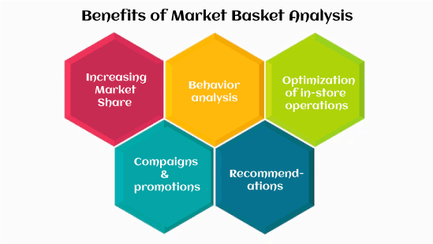

Slide 12
Recommendation System
Recommendation engines are a subclass of machine learning which generally deal with ranking or rating products / users. Loosely defined, a recommender system is a system which predicts ratings a user might give to a specific item. These predictions will then be ranked and returned back to the user.

Slide 13
Collaborative filtering
Collaborative filtering is the process of predicting the interests of a user by identifying preferences and information from many users. This is done by filtering data for information or patterns using techniques involving collaboration among multiple agents, data sources, etc. The underlying intuition behind collaborative filtering is that if users A and B have similar taste in a product, then A and B are likely to have similar taste in other products as well.

Slide 14
Some examples of collaborative filtering algorithms :
YouTube content recommendation to users — recommending you videos based on other users who have subscribed / watched similar videos as yourself.
CourseEra course recommendation — recommending you courses based on other individuals who have finished existing courses you’ve finished.

Slide 15
Content based systems
Content based systems generate recommendations based on the users preferences and profile. They try to match users to items which they’ve liked previously. The level of similarity between items is generally established based on attributes of items liked by the user. Unlike most collaborative filtering models which leverage ratings between target user and other users, content based models focus on the ratings provided by the target user themselves. In essence, the content based approach leverages different sources of data to generate recommendations.

